Slide 1
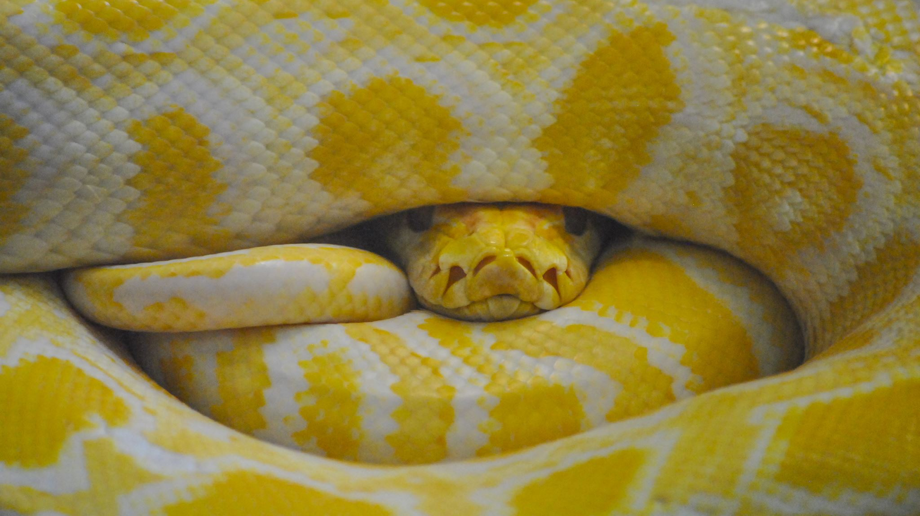
Data Visualization Using Python
Erin Howland & James Bartlett
Tech Camp 2023

Slide 2

Intro Questions
What brings you to Tech Camp?
What are you hoping to learn in this class?
What do you know, or think you know, already about Python and/or data visualization?

Slide 3
Data Jobs
What data-related jobs have you heard of?
What do you think data jobs have in common?
Data Jobs

Slide 4
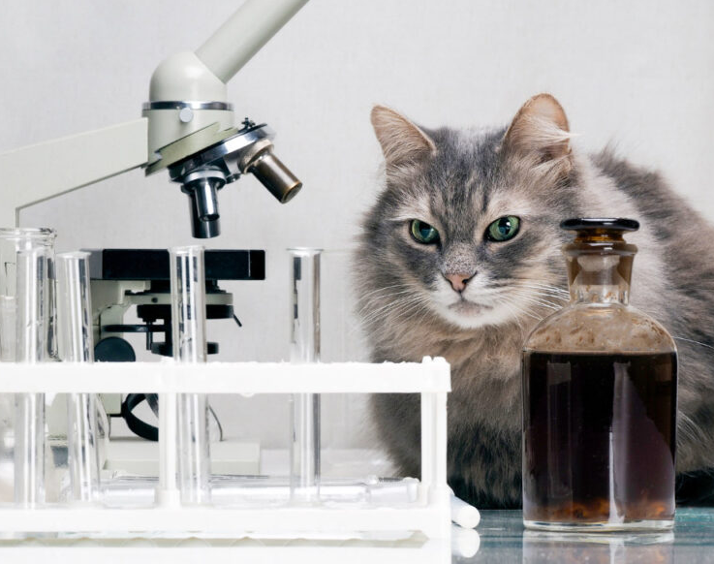
To The Code!

Slide 5
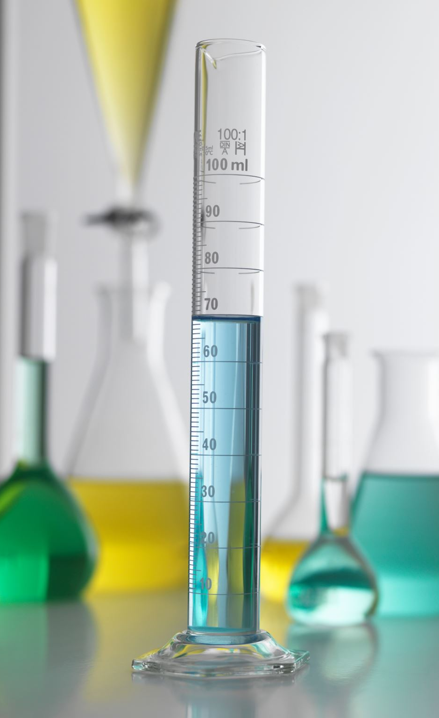
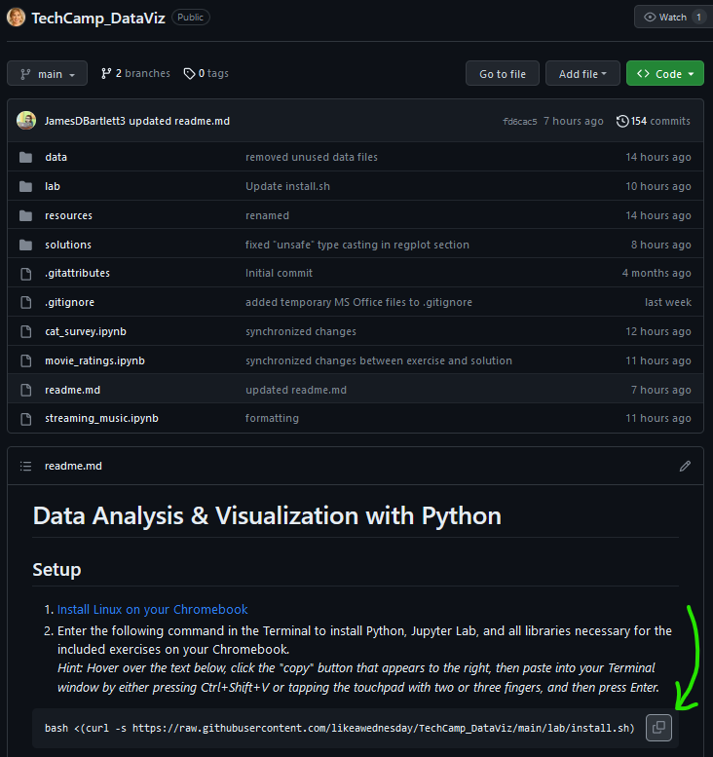
Jupyter Lab Setup
https://GitHub.com/LikeAWednesday/TechCamp_DataViz
Follow instructions at the bottom of the page

Slide 6

Visualizations
What kinds of visuals can you think of?
How do you know what visual to choose?
What makes a visual good or bad?
Visual Vocab

Slide 7
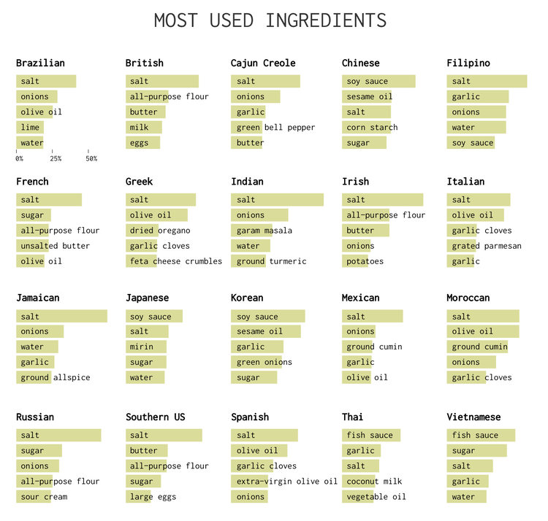
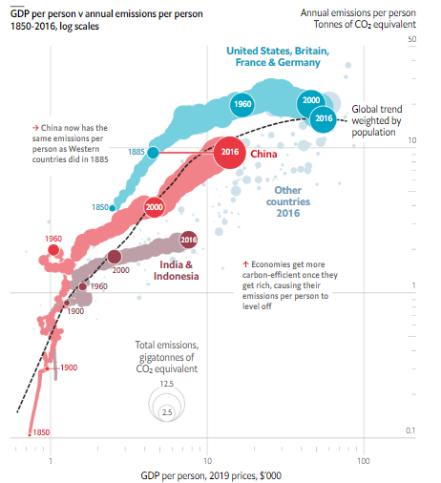
Good Visuals in the Wild, pt I

Slide 8
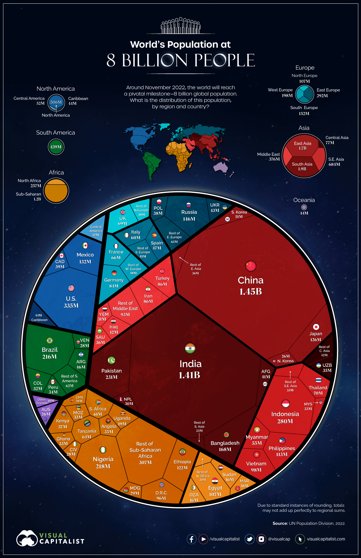
Good Visuals in the Wild pt II
Want some more examples of good visualizations?
Guidelines for Good Visualizations
MIT: How to Make Better Infographics

Slide 9
What Makes a Good Visual?
Know what you are trying to communicate
This will inform chart type, whether ordering is important, if guidelines would be useful, etc.
Understand your audience
Can inform labelling – technical vs. not technical, for example
Think about use of blank space vs. visual clutter
Use of color / accessibility
Resilience to changes in data

Slide 10
Common Errors in Visualizations
Wrong type of chart/graph
Too many variables
Faulty/inconsistent scale
Scale breaks (cropped axis) make small differences seem bigger
Unclear linear vs. logarithmic scale distorts understanding/perception of data
Inconsistent time intervals
Poor color choices
Poor labeling

Slide 11
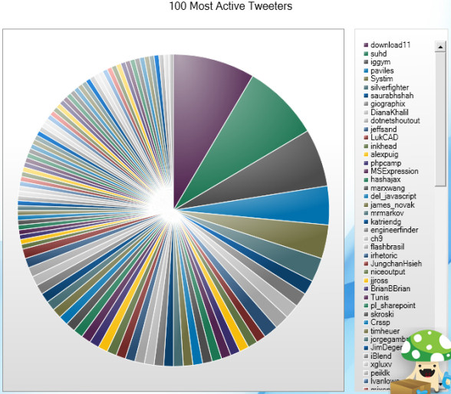
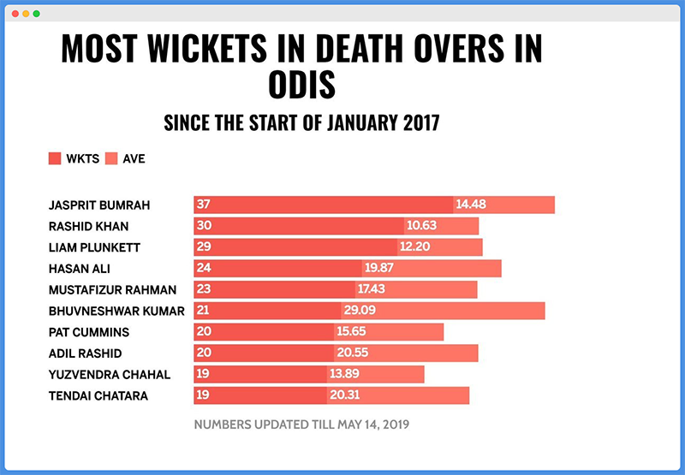
Bad Visuals in the Wild, pt I

Slide 12
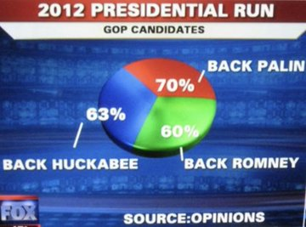
Bad Visuals in the Wild, pt II
Numbers don’t lie (unless you’re as careless as whoever put together this chart), but the methods by which the numbers are gathered and how those numbers are presented can be deceptive.
Want some more bad charts?
Business Insider - 27 Worst Charts
Bad Infographics

Slide 13
Python Libraries
What is a library?
A collection of books, journals, and other resources are stored for use.
What is a Python library?
A collection of code – think of each Python library like a physical library from which you can check out functions rather than books.
Allows us to code more efficiently in Python by not having to rewrite common code blocks that someone else has already written.
Using a Python library is totally OK! It is not considered plagiarism, and is, in fact, encouraged.
Notes:
Data: sample_1_YesNo

Slide 14
What Kinds of Libraries are There?
Just as book libraries tend to focus on specific audiences (general, children, lawyers, etc.) Python libraries tend to specialize in different kinds of tasks:
Data manipulation: Pandas, datatable, PandaPy, NumPy
Web scraping: BeautifulSoup, Scrapy
Visualization: Matplotlib, Seaborn, Plotly, GGplot
AI/ML/complex analysis: Scikit-Learn, NumPy, TensorFlow, PyTorch

Slide 15
How to use Python to Make Visuals?
Our focus is making visuals, but we’ll use some libraries that do other things. This is because we will also need to be able to view and manipulate our data in order to create visuals.
Libraries we’ll import and use today:
Pandas
NumPy
Matplotlib
Seaborn
Squarify

Slide 16

To The Code!
File: cat_survey.ipynb
Dataset: data/cats.csv

Slide 17
Let’s Make Some Visuals!
We’ll look at a sample data set with the following goals:
Learn how to open a flat file in Python and load to a dataframe
Explore data
Consider what story you can tell
Determine what visual(s) might be appropriate to communicate that story
Make some visuals
Different kinds of visuals
Labels and legends
Change colors
Notes:
Data: sample_1_YesNo

Slide 18
Reference: Loading Data & ‘What Now?’
Pandas can read numerous file types
In all instances you will need a file path, so the program knows where to look
We will read files into a dataframe (df), which is basically Pandas’ version of a spreadsheet, but way cooler
I’ve loaded the data. Now what?
View dataframe
What data types do you have?
Is any information missing?
In short, think about the data!

Slide 19
Clean vs. Messy Data
Clean Data
Messy Data
No empty/missing values
Consistent data type in each column (text, integer, date, etc.)
Column headers are names, not values
Data is ready to use!
Messy data can include:
Empty/missing values
Mixed data types in each column
Multiples variables stored in one column
Data requires cleaning
This could be a course in and of itself!

Slide 20
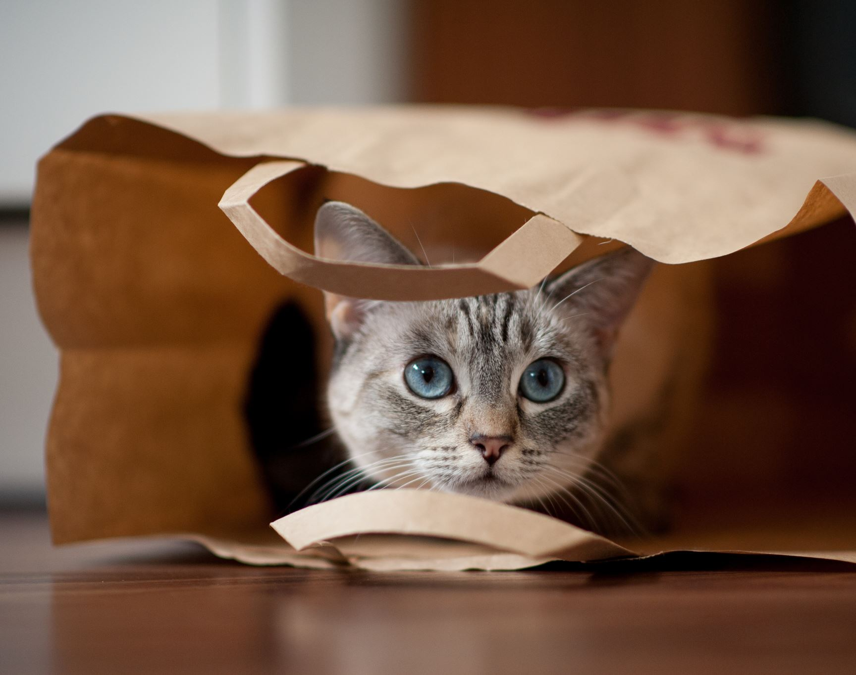
To The Code!
File: movie_ratings.ipynb
Dataset: data/imdb.csv
Focus: Ratings

Slide 21
Let’s Make Some More Visuals!
How would you describe this dataset? Messy? Clean? Somewhere in the middle?
Three primary steps:
Load dataframe
Summary/descriptive info
Visualizations
Think about these questions at each primary step:
Can you see any potential problems?
Why are these problems / What is the risk if these aren’t ultimately addressed (i.e., how might the story change)?

Slide 22
Making Visuals With Less Than Perfect Data
As you may have noticed, the IMDB data was pretty good, but it wasn’t perfect – there were some missing values.
Depending on what you’re investigating, missing values may or may not be problematic. In the last example, because we looked at ratings, our visuals were not impacted since the missing data was not from the ratings column. But what if we were missing data from an area we wanted to investigate?

Slide 23
Handling Missing Data
If you are curious and want to play with this, here are two ways to address missing data:
Impute (fill in) missing data using fillna()
Impute with mean:
df.fillna(mean(), inplace = True)
df[‘column’].fillna(df[‘column’].mean(), inplace = True
Impute with median:
df.fillna(median(), inplace = True)
Impute with mode:
df.fillna(mode(), inplace = True)
Drop rows with missing data using dropna()
Any handling of missing data can influence data analysis, so choose wisely!
Notes:
Look at time to determine which kitty we need next

Slide 24

To The Code!
File: movie_ratings.ipynb
Dataset: data/imdb.csv
How would you handle missing data from the Certificate and/or Metascore column(s)?

Slide 25

To The Code!
Visual-Ready
data/cats.csv
data/imfgdp.csv
Challenge
data/imdb.csv
data/music.csv

Slide 26
Visuals: Choose Your Own Adventure!
If you want to work with clean, perfect data and focus only on visuals and customization of visuals, see Visual-Ready List
If you want a little more of a challenge with data quality and Python coding beyond just what’s needed for visuals, see Challenge List
Keep in mind: you can use data from either set! Just be aware of your goals and what question(s) you are looking to answer with your visuals. There are no macho points ☺

